Slide 1

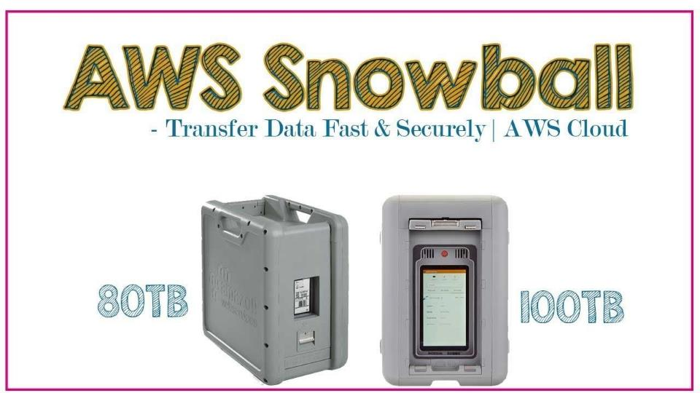

Slide 2

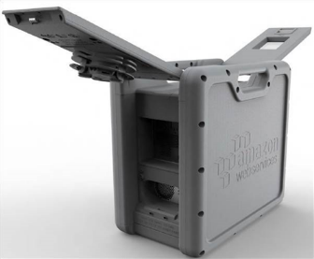
What is Snowball
Snowball is a petabytes scale data transport solution that uses secure appliances to transfer large amounts of data into and out of AWS.
Using snowball addresses common challenges with large scale data transfers including high network costs long transfer times and security concerns.
Transferring data would Snowball is simple, fast, secure and can be as little as one fifth the cost of high-speed Internet

Slide 3
What is Snowball
Snowball comes in two flavors i.e., 50 terabytes or 80 terabytes.
Snowball uses multiple layers of security designed to protect your data including tamper resistant enclosures, 256-bit encryption and an industry standard Trusted Platform Module (TPM) designed to ensure both security and full chain of custody of your data.
Once your data transfer job has been processed and verified, AWS performs a software erasure of the Snowball appliance.

Slide 4
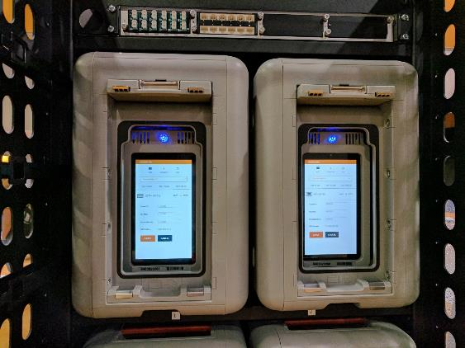
What is Snowball Edge
Snowball edge comes in 100 terabytes data transfer device with an onboard storage and compute capabilities. You can use snowball edge to move large amounts of data in and out of AWS as a temporary storage tier for a large local data sets or support local workloads in remote or offline locations

Slide 5

What is Snowball Edge
Snowball edge connects to your existing applications and infrastructure using standard storage interfaces, streamlining the data transfer process and minimizing set up an integration. Snowball edge can cluster together to form a local storage tiers and process your data on-premise, helping ensure your applications continue to run even when they are not able to access the cloud

Slide 6
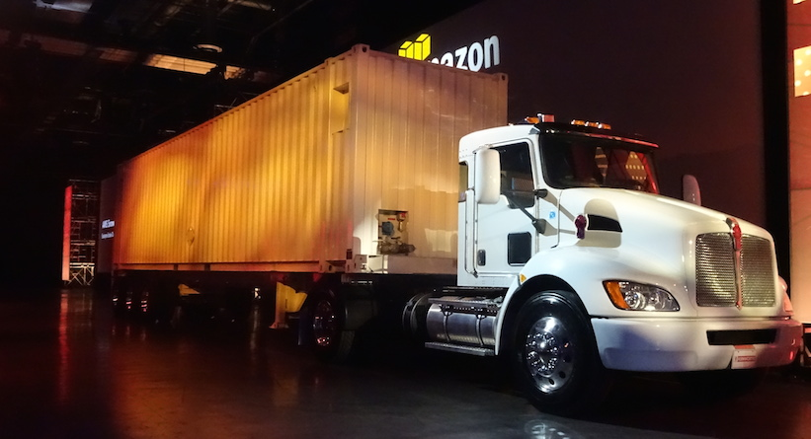
What a Snowmobile

Slide 7
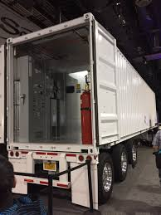
What a Snowmobile
Snowmobile is an exabytes scale data transfer service used to move extremely large amounts of data to AWS. You can transfer up to 100 petabytes per snowmobile, a 45-foot-long ruggedized shipping container, pulled by a semi-trailer truck.
Snowmobile makes it easy to move massive volumes of data to the cloud, including video libraries, image repositories or even a complete data center migration.
Transferring data with Snowmobile is secure, fast and cost effective

Slide 8

Exam Tips
Snowball can import to S3 and export from S3

Slide 9
Thank you

